Slide 1
CMPE 266 Group Project Final Report
Group1 Xinyu He, Vineet Batthina, Ling Qing

Slide 2
Project Description
When you are travel or do research in the wild word and meet unknown an animal, you can take picture through your camera or smartphone, connected the real-time data to a remote services to recognize the animal and receive the information of this animal fast, so that you can take action accordingly.

Slide 3
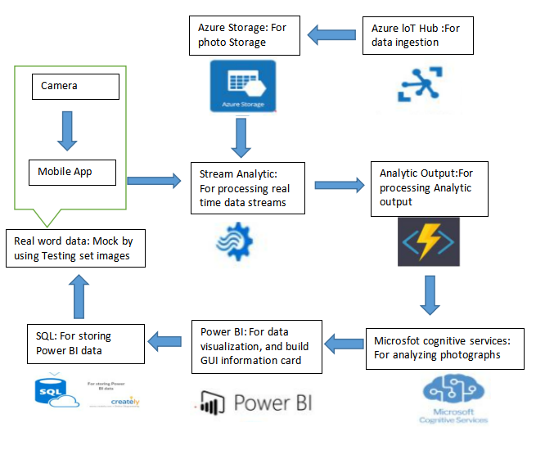
Architectural Overview
On user side:
Take a picture
Sending the picture from mobile app to remote service
Get responding from remote services to get information card to tell detail about the animal

Slide 4
Architectural Overview
On services sides:
Training set image to Azure loT Hub
Photo storage
Receive the testing set image, and analytic according to the photo in storage
Processing Analytic output
Analyzing phtograhps
Data visualization
SQL storage.

Slide 5

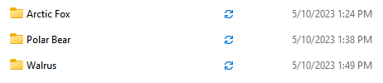
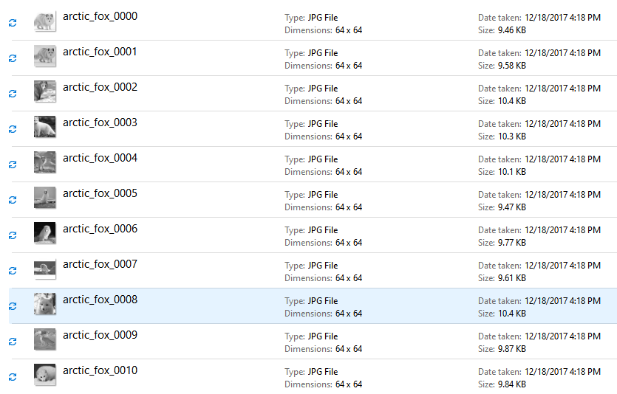
DB Schema, data statistics
Three species : Arctic Fox, Polar Bear, Walrus
Training set: 100 images each
Testing set :15 images each to mock the real time data
Sample data

Slide 6
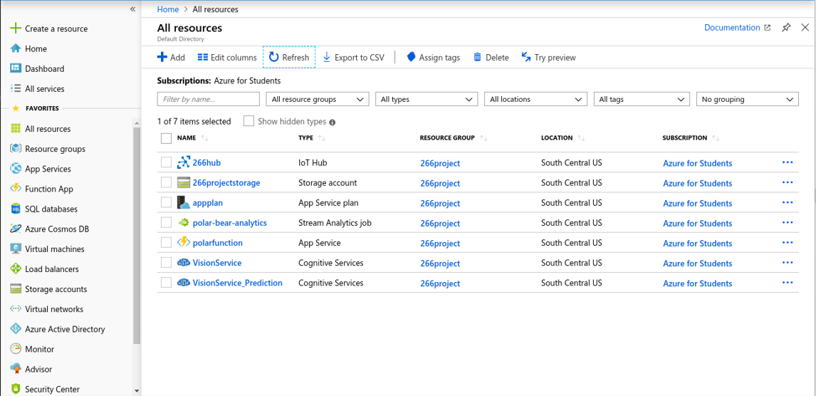
Tool Used
Microsoft Azure IoT Hub: This can be used to ingest any kind of streaming data via a simulated recording media for example - cameras.
Microsoft Azure Storage: Any kind of streaming data can be stored here.
Microsoft Azure Stream Analytic: This service can be used to process real-time data streams.

Slide 7
Tool Used
4. Microsoft Azure Function: This service can be used to process outputs from the Stream Analytic service.
5. Microsoft Custom Vision Service: This service can be used to analyze/recognize images.
6. Microsoft Power BI: This service can be used to create customized dashboards for data visualization.

Slide 8
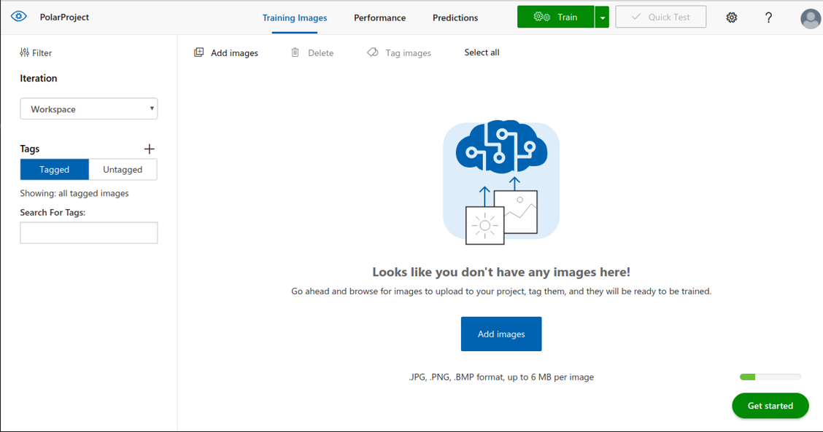
Implementation-Training data
Input training data

Slide 9
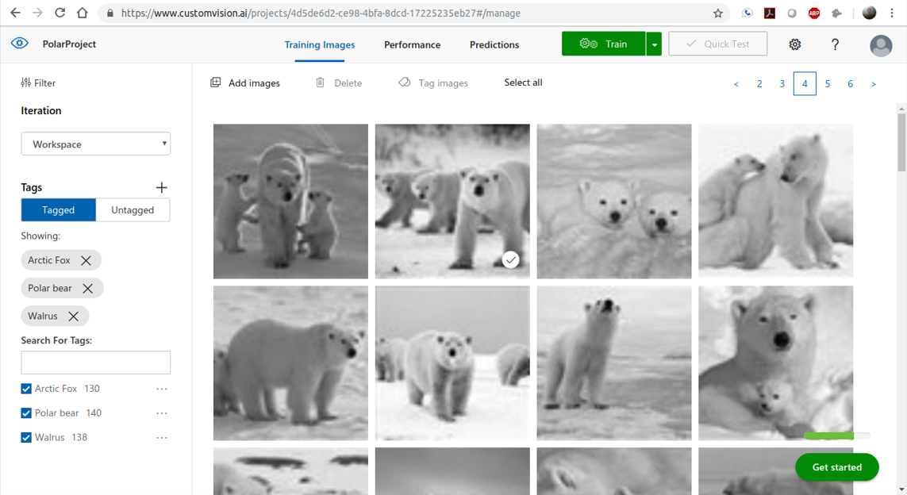
Implementation-Training data Storage
All training data for three species

Slide 10
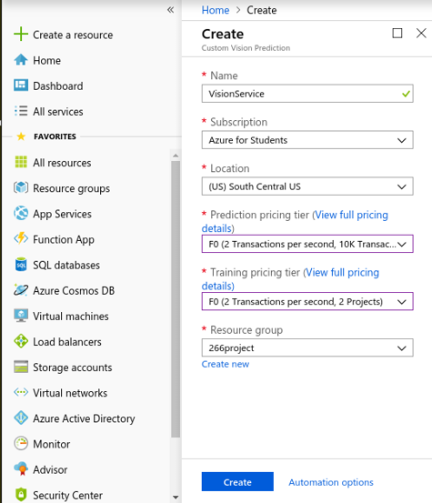
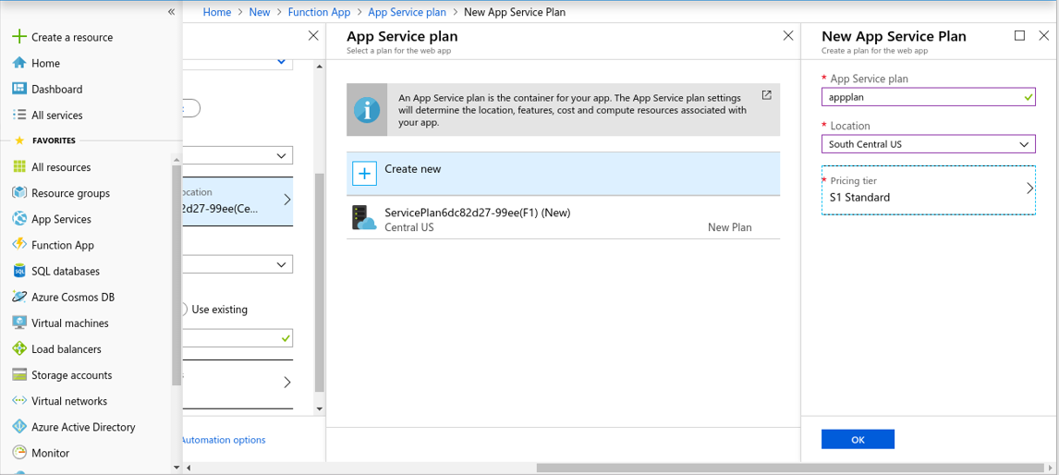
Implementation-Service

Slide 11
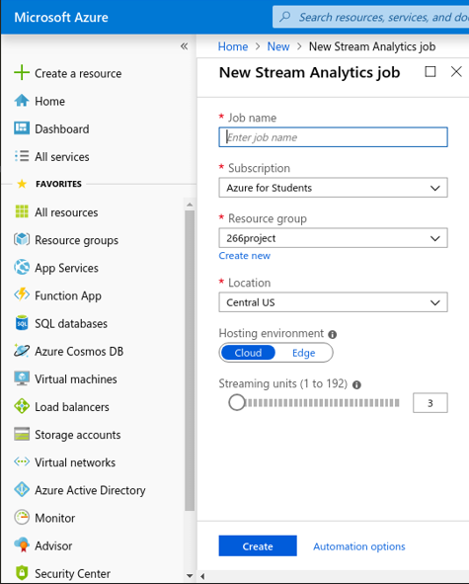
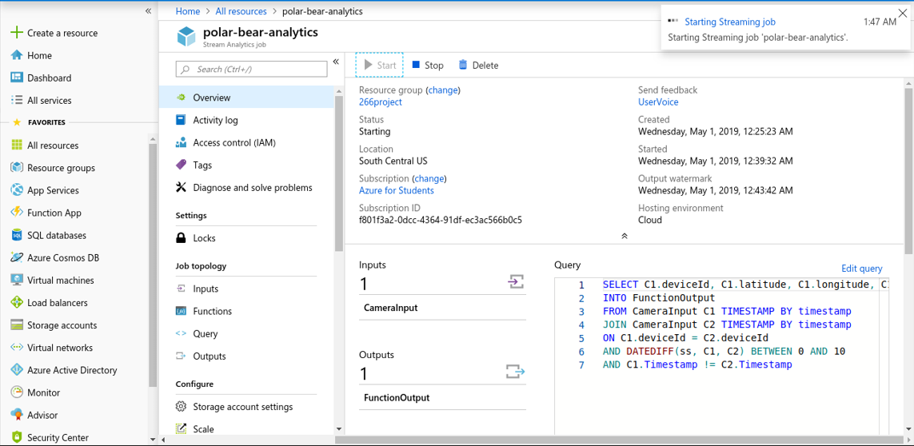
Implementation-Stream Analysis

Slide 12
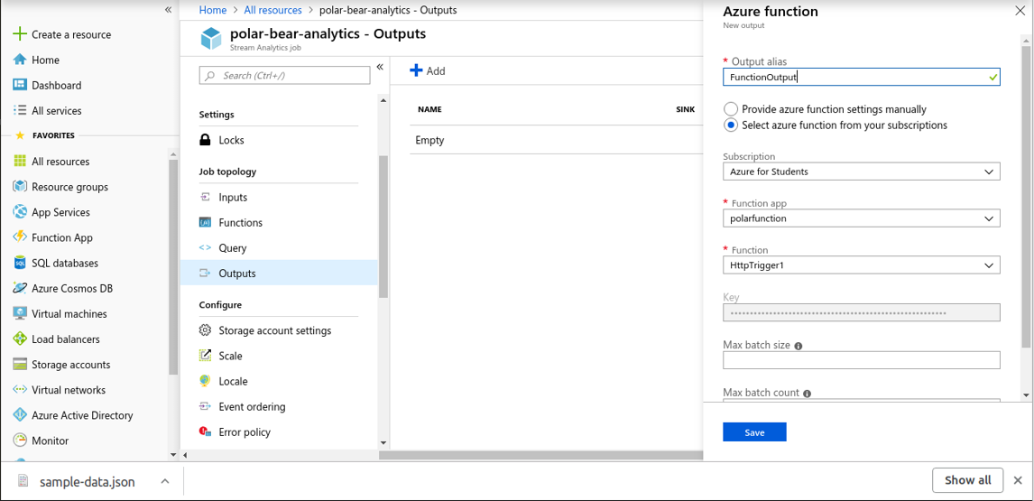
Implementation-Stream Analysis Output

Slide 13
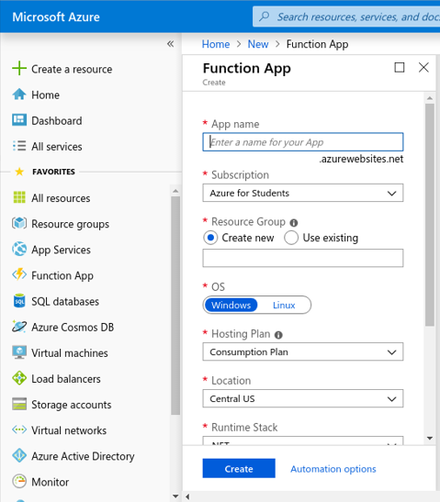
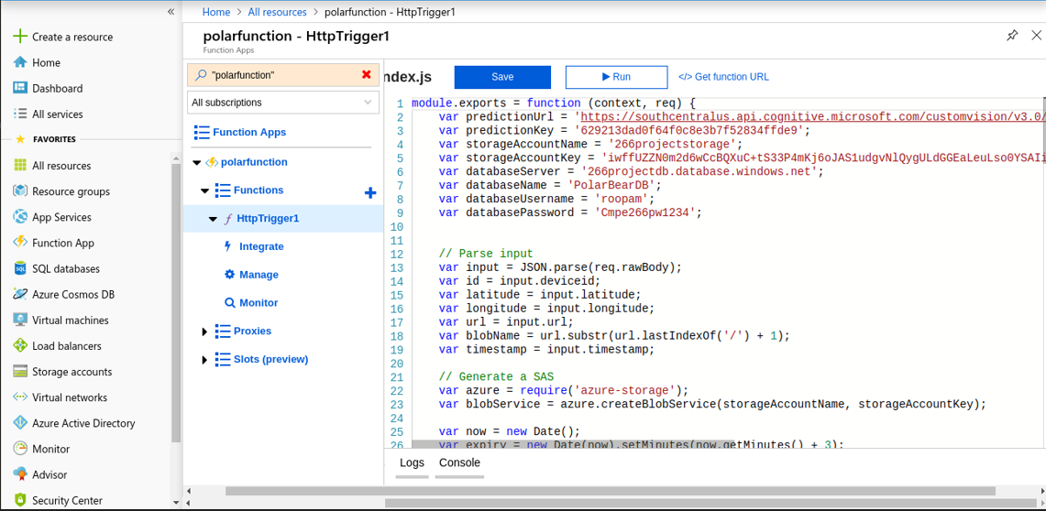
Queries performed-Function

Slide 14
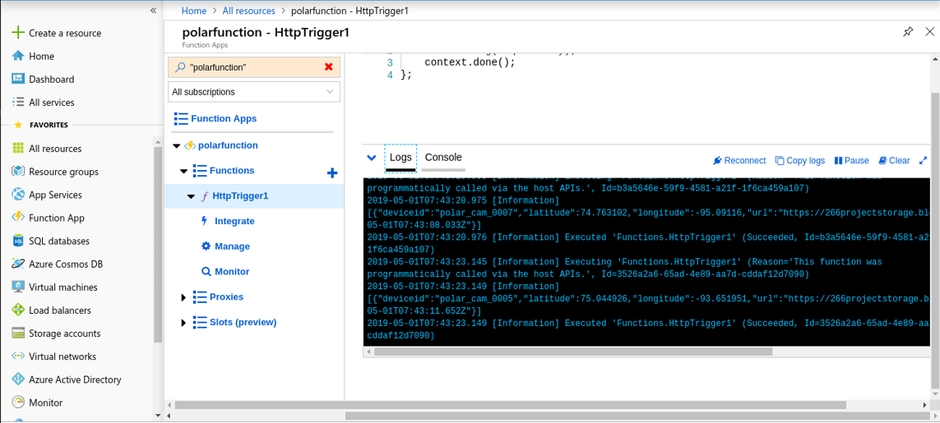
Queries performed-Function

Slide 15
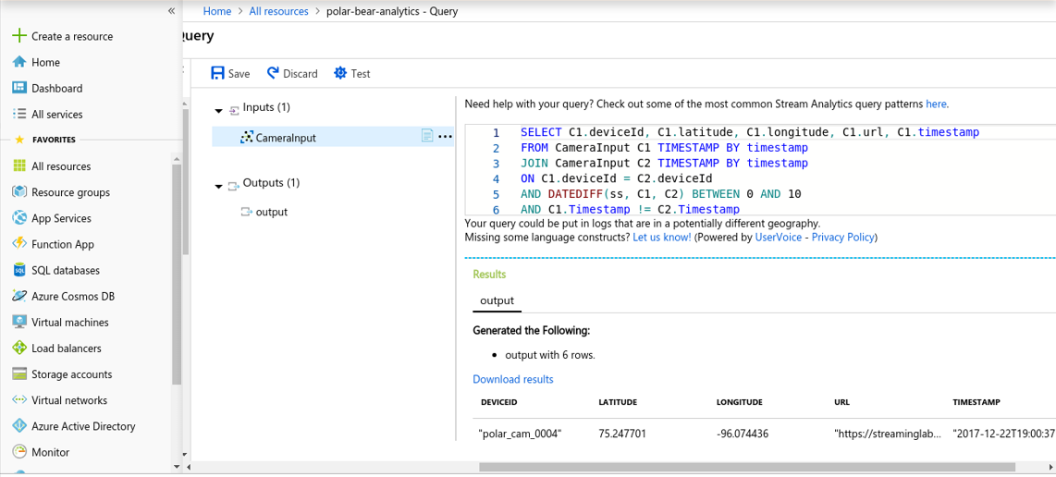
Queries performed-Input

Slide 16
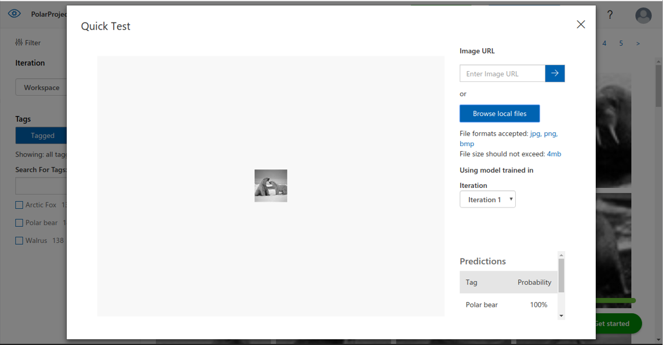
Queries performed-Test
Sample test

Slide 17
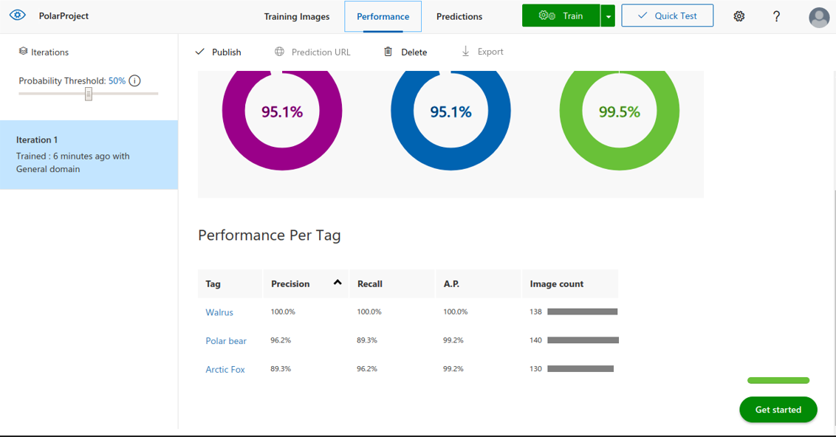
Queries performed-Results
Regular Test results:
Testing set from Three species

Slide 18
Lessons Learned
Microsoft Azure Tools: Learn more about how to use this tools
Software develop life cycle(waterfall):
Draw flowchart at the beginning to help manage schedule better

Slide 19
Open issue/future work
Open issues:
1. can not tell differences between similar species. For example: can not distinguish polar bear and other bears.
Solution:need more factors help to distinguish, such as the location of the data sending.
Future work:
1. Front end Mobile app
2. Collecting more data for more species

Slide 20
System requirements and environment
Microsoft Azure can be used in both Linux and windows system. All the service provided by Azure and do not require to install any software.
We are using the windows system, used the GUI interface

Slide 21
Github link
https://github.com/Jeremiah0715/CMPE266_Group_Project

